Slide 1
Making PADR Meaningful

Slide 2
Today you will learn:
Why PADR’s are important
How to prepare for the PADR (appraisal)
The principles of conducting an effective PADR
How to set effective objectives
How to populate a personal development plan
How to complete a PADR using the correct documents

Slide 3
Have a think about what aspects of the PADR process do you have responsibility for?
For how many members of staff?
How much experience have you had in undertaking PADR’s
What do you already know about the NHS Wales Pay Progression Policy?
What aspect of the PADR process do you find most confusing/frustrating /daunting?

Slide 4
For how many members of staff?
No more than 6-10 as this can be difficult to manage. You should ‘know and understand’ the Reviewee’s work
How much experience have you had in undertaking PADR’s?
If you are new to this it may feel daunting but remember it is about having a ‘meaningful’ PADR. It is beneficial to plan your meeting and plan an agenda you want to cover
What do you already know about the NHS Wales Pay Progression Policy?
This is now recorded in the PADR document and you need to be familiar with the policy before the PADR meeting
What aspect of the PADR process do you find most confusing/ frustrating/daunting?
There is lots of guidance and an example of a good PADR on the PADR Resource Intranet page which may help

Slide 5
Foundations

Slide 6
P
A
D
R
ersonal
ppraisal
evelopment
eview
Starting with the Basics:

Slide 7
Why are PADR’s Important?
Why should PADR’s be valued by you & your team?

Slide 8
Personal & professional development
Positive impact on Patient care & outcomes
What’s the point of a PADR?
Contributing to individuals feeling valued
Reinforcing & embedding Values & Behaviours
Relationship building & establishing shared understanding between colleagues
Establishing clarity about targets, priorities & individual contribution
Contributing to a culture of a high performing teams

Slide 9
The delivery of high quality care within the NHS depends on every member of staff:
Having a clear understanding of their role and the part they play in their team and organisation
Having an agreed set of priorities and objectives for their work
Possessing and applying the knowledge and skills they need to perform that role effectively and to achieve their objectives

Slide 10
Giving Feedback: The Golden Rules Feedback is the cheapest, most powerful, yet most underused management tool at any leader’s disposal. It helps people get on track and serves as a guide to assist people to know how they and others perceive their performance. Good feedback can be highly motivating and energising. It has strong links to increased employee satisfaction and productivity and makes people feel involved with their organisation and role.

Slide 11
1. NO SUPRISES - An annual review is not the time to bring up a specific incident from a long time ago or something that might surprise the individual, if they thought it was water under the bridge. Surprising people can lead to an emotional response, which is definitely best avoided when providing feedback. Where possible, a specific issue or event should be dealt with immediately or as soon as possible after it occurs.
2. NOT ABOUT PERSONALITY - Managers must try to separate the person from the performance. Examples of behaviour must always take precedence over impressions of personality. Feedback should be about what a person does or doesn’t do, not who they are. Feeding back about an individual’s personality provokes that emotional response that managers want to avoid. After all, the objective of feedback is not to change a person, just change what they do or how they do it
3. PRAISE WHAT YOU CAN - Discussions should be in the context of the individuals overall performance.
Research has suggested that the ratio of positive to negative feedback should be 5:1 – do you give 5 times the amount of positive feedback as developmental feedback? If the manager focuses only on the negatives then this can undermine a person’s confidence and motivation over time. Want a balanced reaction? Give balanced feedback.
1. NO SUPRISES An annual review is not the time to bring up a specific incident from a long time ago or something that might surprise the individual, if they thought it was water under the bridge. Surprising people can lead to an emotional response, which is definitely best avoided when providing feedback. Where possible, a specific issue or event should be dealt with immediately or as soon as possible after it occurs. 2. NOT ABOUT PERSONALITY Managers must try to separate the person from the performance. Examples of behaviour must always take precedence over impressions of personality. Feedback should be about what a person does or doesn’t do, not who they are. Feeding back about an individual’s personality provokes that emotional response that managers want to avoid. After all, the objective of feedback is not to change a person, just change what they do or how they do it. PRAISE WHAT YOU CAN Discussions should be in the context of the individual’s overall performance. Research has suggested that the ratio of positive to negative feedback should be 5:1 – do you give 5 times the amount of positive feedback as developmental feedback? If the manager focuses only on the negatives then this can undermine a person’s confidence and motivation over time. Want a balanced reaction? Give balanced feedback.

Slide 12
The Importance of High Quality PADR
“Most interestingly, engagement was generally lower among those people who had received a poor quality appraisal than those who had received no appraisal at all.
This suggests that an appraisal meeting which is not well-structured can be counter-productive, leaving the employee feeling less motivated about his/her work and organisation.”
Source: Kings Fund - Employee engagement and NHS performance, Michael A West (Lancaster University) & Jeremy F Dawson (University of Sheffield)

Slide 13
Direct Link Between Appraisal & Patient Mortality
Evidence from research linking patient deaths with key HR practices:
Appraisal has the strongest link with overall patient mortality
A hospital which trains approx 20% more appraisers & appraises approx 20% more staff & is likely to have 1,090 fewer deaths per 100,000 admissions
Source: Effective Human Resource Management & Lower Patient Mortality, Carol Borrill & Michael West, Aston University Conclusions drawn based on analysis of two specific areas of mortality: deaths after admissions for hip fracture, and deaths within 30 days of emergency surgery

Slide 14
Aneurin Bevan University Health Board NHS Wales Staff Survey Results 2018
81% said their PADR helped them agree on clear work objectives
What did we say?
88% of our Workforce had their PADR
48% agreed their training, learning & development has helped them do their job better
66% said they felt their review left feeling valued by the organisation
53% felt it would help improve how they did their job

Slide 15
Influences on PADR
* TOP TIP *
If sickness absence, maternity/paternity leave is planned during the time a PADR is due – plan to complete before the absence to ensure compliance & PAY PROGRESSION are not missed.
Sickness
Maternity/ Paternity Leave
Team dynamics
Changes
Workload
Role clarity
Job satisfaction
Career aspirations
…&…?
* TOP TIP *
Overcome reluctance to participate by explaining the benefits of an effective PADR.
PADR is mandatory but it is not just a ‘tick box’ - MAKE IT MEANINGFUL

Slide 16
The PADR Process

Slide 17
Existing Staff Annual Review 8-12 weeks before increment date
New Staff
6-12 weeks
from starting post
8-12 weeks before increment date
Annual Review

Slide 18
Who & when
WELLBEING
Use the Employee Experience Framework as guide for discussion
PADR Details
VALUES & BEHAVIOURS
2-way discussion of what’s gone well and less well, successes and challenges
OBJECTIVES
Agree dates for achievement of mandatory objectives
Discuss & agree individual objectives relevant to role & career aspirations
PDP
Discuss and agree training and development needs to meet objectives, any professional or workplace changes & career aspirations
Code of Conduct
Secondary Employment
Declaration of Interest
NMC Revalidation
Discuss how the member of staff has demonstrated the Health Board’s Values through their behaviour
DISCUSSION
PAY PROGRESSION DECISION
SUMMARY
Overall comments
Confirmation signatures

Slide 19
What should you do to prepare for the PADR discussion?

Slide 20
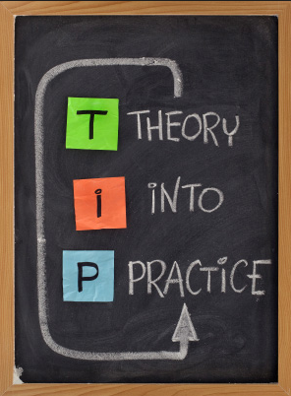
Tips for Reviewers
Provide a copy of the PADR form at least 2 weeks prior to date of discussion
A private room should be booked for at least an hour
Obtain a copy of Job Description and Person Specification
Reflect on & look for evidence & examples of issues that you want to discuss in the PADR
Plan the discussions you want to have and make sure you cover your agenda
Refer to the PADR Resource Page on the Intranet for further support

Slide 21
What hints & tips do you have for engaging in a meaningful discussion of performance & behaviour?
(both good & less good performance or behaviour)

Slide 22
Who Does Most of the Talking?
It should be the Reviewee who does most of the talking as it is ‘their’ PADR. They need to plan for the PADR meeting prior and plan objectives for the following year. The Reviewer should ask questions to clarify, gain further insight and explore

Slide 23
Questioning Skills
Closed questions only allow for a single word or short answer
Open questions such as: ..‘how have things been?’ allows the person to tell you anything at all about what has been happening
Focused questions do just as the name describes; they focus down onto a particular area and then explore it further: ‘Can you tell me more about…?’
Direct questions may have a place such as: ‘How does your working relationship with Bob affect your home life?’
Multiple questions and leading question styles are best avoided to ensure that the Reviewee remains the focus and the PADR meeting does not turn into an ‘interrogation’
Notes:
23

Slide 24
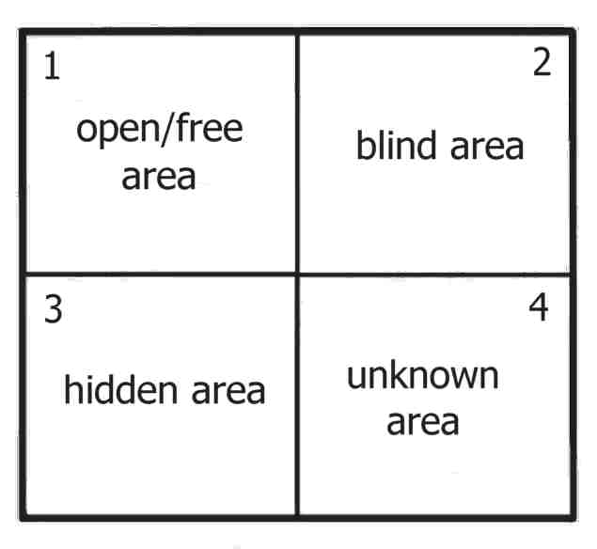
Johari’s Window
Notes:
The "open" quadrant represents information about the person - behaviour, attitude, feelings, emotion, knowledge, experience, skills, views, etc - known by the person ('the self') and known by the group ('others'). The size of the open area can be expanded horizontally into the blind space, by seeking and actively listening to feedback from other group members.
The “blind” quadrant represents what is known about a person by others in the group, but is unknown by the person him/herself. By seeking or soliciting feedback from others, the aim should be to reduce this area and thereby to increase the open area, ie, to increase self-awareness. This blind area is not an effective or productive space for individuals or groups. This blind area could also be referred to as ignorance about oneself, or issues in which one is deluded. A blind area could also include issues that others are deliberately withholding from a person. We all know how difficult it is to work well when kept in the dark. No-one works well when subject to 'mushroom management'. People who are 'thick-skinned' tend to have a large 'blind area'. Managers can take some responsibility for helping an individual to reduce their blind area - in turn increasing the open area - by giving sensitive feedback and encouraging disclosure.
The "hidden" quadrant contains what is known to ourselves but kept hidden from, and therefore unknown, to others. This hidden or avoided self represents information, feelings, etc, anything that a person knows about him/self, but which is not revealed or is kept hidden from others. The hidden area could also include sensitivities, fears, hidden agendas, manipulative intentions, secrets - anything that a person knows but does not reveal, for whatever reason. It's natural for very personal and private information and feelings to remain hidden, indeed, certain information, feelings and experiences have no bearing on work, and so can and should remain hidden. However, typically, a lot of hidden information is not very personal, it is work- or performance-related, and so is better positioned in the open area. .
The "unknown" quadrant contains information, feelings, latent abilities, aptitudes, experiences etc, that are unknown to the person him/herself and unknown to others in the group.
The process of enlarging the open quadrant is called self-disclosure, a give and take process between me and the people I interact with. Typically, as I share something about myself (moving information from my hidden quadrant into the open) and if the other party is interested in getting to know me, they will reciprocate, by similarly disclosing information in their hidden quadrant. Thus, an interaction between two parties can be modeled dynamically as two active Johari windows. For example, you may respond to my disclosure that I like "Cherry Garcia" by letting me know what your favorite ice cream is, or where a new ice cream shop is being built, kinds of information in your hidden quadrant

Slide 25
Active Listening Skills
Concentrate
Ask questions
Sit so you can see & hear
Avoid prejudices
Ask for clarification
Take notes?
Eliminate distractions
Focus on the speaker
Maintain an open mind
Look for nonverbal cues
Do not react negatively to emotive words

Slide 27
What Is An Objective?
A statement of what is to be achieved
The ‘end point’
Some objectives can be ‘maintenance tasks’ but they must be priorities
Some objectives will be ‘special tasks’ over and above routine work

Slide 28
Exploring Objectives:
How many objectives?
Over what time period?
Can they be changed?
How easy or difficult?
Where do an individual’s objectives come from?

Slide 29
Exploring Objectives:
How many objectives?
No limit but they need to be able to be achieved within the timeframe
Over what time period?
Ideally within the year but some can be carried over e.g. undertaking a qualification
Can they be changed?
Yes they can as the situation can change
How easy or difficult?
They should ‘stretch’ the individual
An Reviewee’s objectives should come from the individual, a training or department need to improve services, patient care and help the individual to do their job to the best of their ability

Slide 30
Training is…?
…the process through which the knowledge, skills and attitudes required by an individual in order to perform a task are either improved or modified

Slide 31
Types of Development Need:
Essential
Mandatory or statutory
Related to profession or registration
Performance improvement
New technology or practices
Desirable
For organisation or individual
E.g. Career development or preparing for longer term strategic business needs

Slide 32
Individual Perspectives:
How do you want your present role to develop?
What are your long-term career aims?
What should your next role be?
How about family and social aims?
What personal skills would you like to develop?
Do you have the necessary skills and resources to be able to do your job to the best of your ability, what do you need to develop?

Slide 33
Training & Development Considerations for the Reviewer
Will the activity meet the agreed objective?
Is it a good match for the individual’s learning style?
Do you have team/workload flexibility to enable attendance?
Can you afford to do it?
Can you afford NOT to do it?
Is the timeframe suitable?
Do you need official authorisation?
You may want to ask your line manager ahead of meeting e.g. if you predict that Reviewee may want to undertake a training course you can ask Manager if able to to give decision at time of PADR meeting

Slide 34
Good Practice
Confidentiality
No big surprises
Put at ease
Start positively
Guide a 2-way discussion
Ask open questions
Actively listen to answers
Encourage & praise
Give & receive feedback
Cover your agenda
Allow Reviewee to address all their issues
Make notes & record agreements
Set follow-up dates
Conclude positively
Record on ESR

Slide 35
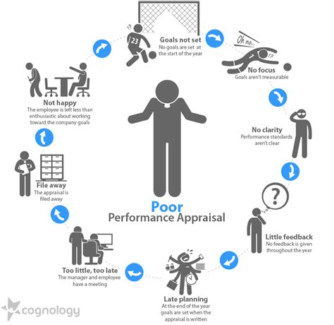
☹

Slide 36
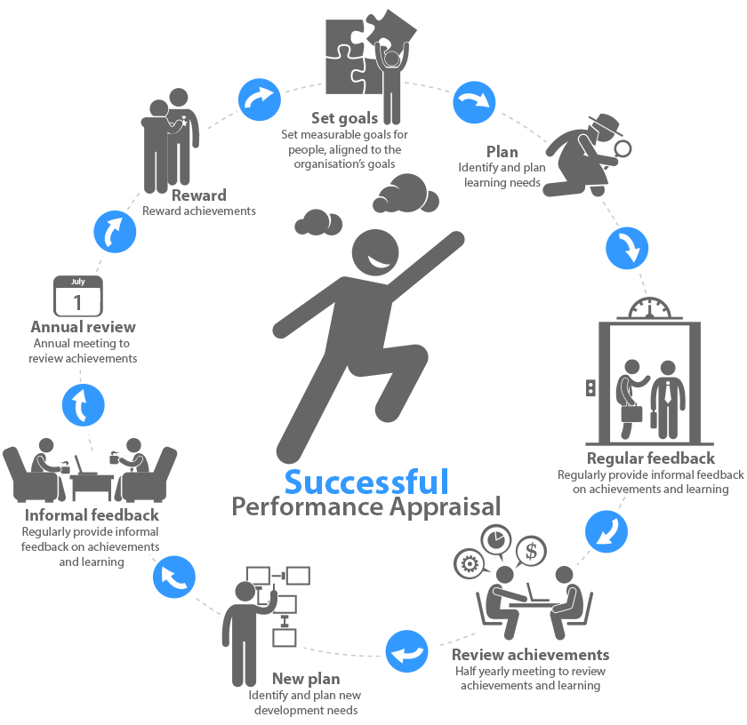
☺

Slide 37
Final Information

Slide 38
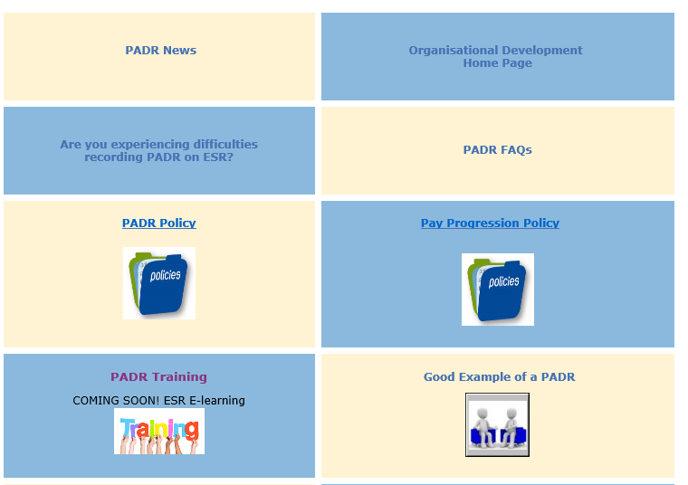
PADR Resources available on the Intranet

Slide 39
Pay Progression
An employees’ pay step is awarded on satisfactory completion of the employees PADR, even if there may be some years which do not have a pay award attached to the pay step
This is subject to the employees’ satisfactory performance, no live disciplinary sanctions, not being under formal capability process and being fully up to date with statutory and mandatory training
For more information go to:
All Wales Pay Progression policy

Slide 40
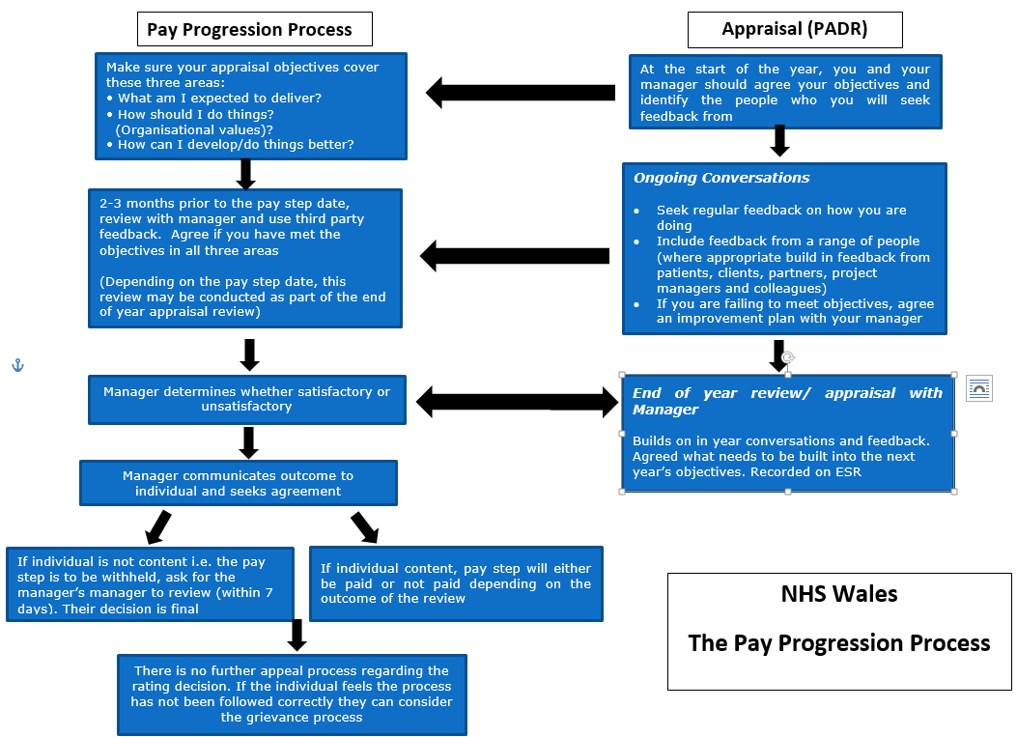

Slide 41
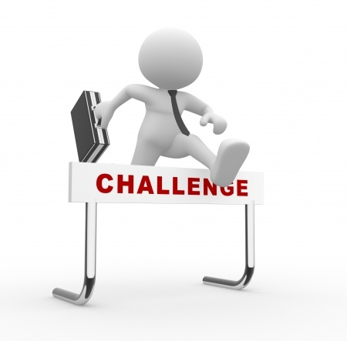
Putting it into Practice…?
How will PADR conversations help you implement Clinical Futures?
How are you feeling about undertaking your next PADR?
Do you have any implementation challenges?
& what advice can we collectively offer to help you overcome them?

Slide 42
Further support is available from:
Divisional PADR Leads
Unscheduled Care: Bev Cadman, Annie Ming, Christopher Morgan
Scheduled Care: Andy Terry, Angela Palfrey
Family & Therapies: Gwyneth Ratcliffe
Mental Health & Learning Disabilities: Sarah Cadman
Locality Primary Care/ CHC: Angela Powell
Facilities: Michelle Key

